Slide 1
Mixed Circuit Practice – Feb 26 (Electricity & Magnetism Day 06)
Agenda
Mixed Circuit Practice
Worksheet: Complex Circuit Problems
Past Work
Equivalent Resistance Worksheet
Basic Circuit Analysis Worksheet
Upcoming
Due TODAY: Ohm's Law Lab (Full Lab Report)
Tomorrow: Circuit Analysis Quiz

Slide 2
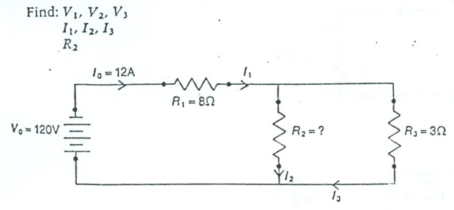
Warm-Up Question
Strategy:
Determine I₁
Calculate V₁
Determine V₂ and V₃
Calculate I₃
Determine I₂
Calculate R₂

